Slide 1
Sandbridge Technologies, Inc.
Summerhill AGM Presentation
May 4 & 5, 2009
  Paul Vroomen
  President/CEO
  Sandbridge Technologies, Inc.
  120 White Plains Road
  Tarrytown, NY 10591
  pvroomen@sandbridgetech.com

Slide 2

Company Vision
Sandbridge Leverages Programmability to Build Market Share Leadership in Smartphone Silicon
www.sandbridgetech.com Confidential & Proprietary
www.sandbridgetech.com Confidential & Proprietary
2

Slide 3
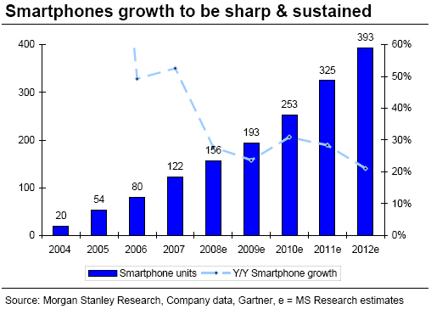
Smartphone Market
Baseband SAM: ~$3.5B (2012e, ASP $8.50 est.)
Unit CAGR: >20% ’07 – ’12
Sufficient scale and growth to generate venture returns on a typical semiconductor investment
www.sandbridgetech.com Confidential & Proprietary

Slide 4
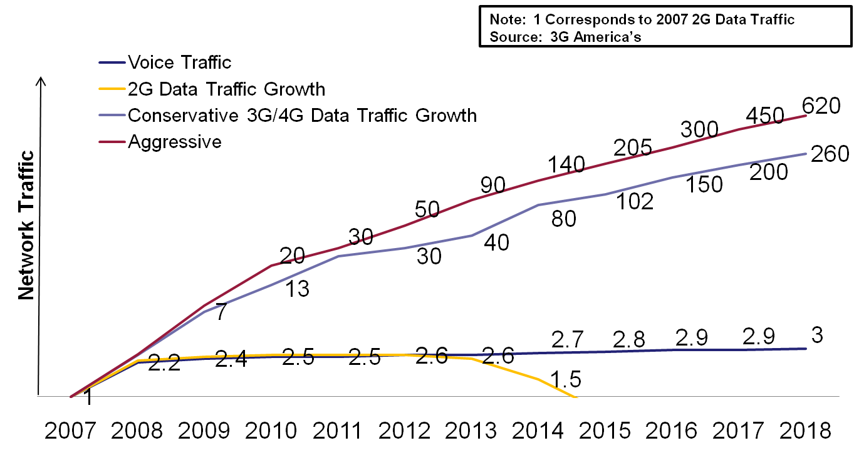
Broadband data drives ARPU (Average Revenue Per User)
Projected Operator Traffic Growth (developed markets)
20 November 2014
www.sandbridgetech.com Confidential & Proprietary
4

Slide 5
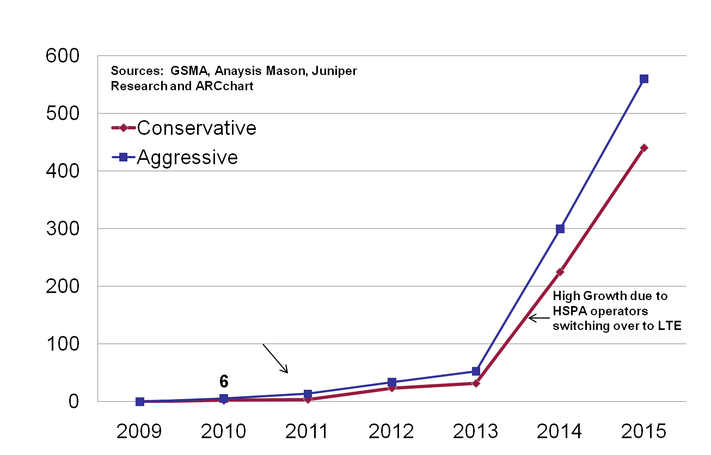
Long Term Evolution (LTE = 4G) WW Subscriber Growth Forecast
560
Worldwide LTE Subscribers (millions)
440
300
225
Primary growth is coming from CDMA operators and early adopter HSPA operators
34
53
0
14
24
32
2.4
4.2
20 November 2014
www.sandbridgetech.com Confidential & Proprietary
5

Slide 6
Secondary Markets
Femtocells
  Cellular access points covering home or small business
  Wildly divergent analyst forecasts
    63.5MU installed base by 2013 - ABI Research 10/2008
    2.5MU installed base by 2012 - Gartner 10/2008
  No significant shipments in 2008, but several trials and early deployments underway (Verizon, AT&T, KDDI, Softbank, Sprint…)
  Carrier business case driven by reduced capex (100 femtos = 1 macro Basestation; subscriber pays for femto); competition from Wifi (T-Mobile, Orange, BT…)
PC Connectivity
  USB Dongles and datacards providing cellular broadband data access using 3G/4G, Wimax…
  Market forecasts not found, but we estimate that ~10% of laptops and 90% of Mobile Internet Devices (MIDs/Web books) will have cellular broadband capability in 2011
  Orange UK subsidy business model proving very successful in Europe
    Free entry level laptop if customer signs up to 2 year broadband cellular data service
www.sandbridgetech.com Confidential & Proprietary

Slide 7
Sandbridge Opportunity
Sandbridge Total Available Market (2011):
Smartphones: 325MU $3.4B at $10.35 ASP
PC Connectivity: 55MU $0.45B at $10.00 ASP
Femtocells: 5MU? $0.1B at $20.00 ASP
--------
TOTAL: $3.95B
www.sandbridgetech.com Confidential & Proprietary

Slide 8
Smartphone Market
Customers, by market share:
Source: Gartner, March 2009
www.sandbridgetech.com Confidential & Proprietary

Slide 9
Smartphone Market
Competition, by market share
www.sandbridgetech.com Confidential & Proprietary

Slide 10
Sandbridge Value Proposition
Flexibility
  Enables agile product planning in volatile, rapidly changing market
  Enables fastest time to market for new or changing standards
  Enables customization and competitive differentiation through software
Cost
  Minimizes BoM cost by reducing baseband to single device for most smartphone radios
  Minimizes die size, and therefore cost, vs hardwired competitors by re-using transistors for multiple radios
  Streamlines inventory and reduces development cost by enabling single platform for many handsets
Power
  Lower power than other programmable devices: 10x lower than TI C64; 3X lower power than Icera
  Within 20% of 3G hardwired baseband for same task load – confirmed by partner
www.sandbridgetech.com Confidential & Proprietary

Slide 11
Sandbridge Strategy
Platform - 2008
Smartphone: Samsung, RIM, LGE, Nokia
Secondary: KDDI, NSN, other femto
SB3500, Compiler, Simulator,
Function Library, Development Board
Broadband Solution - 2009
Smartphone: BB modem + cellular?
Secondary: Worldwide PC/MID OEMs
Certified protocol stack, physical layer
PC Card form factor reference design
Broadband protocols
Cellular Solution - 2010
Smartphone: Entire TAM
Secondary: Entire TAM
Certified protocol stack and physical layer
Smartphone form factor reference design
Cellular protocols
www.sandbridgetech.com Confidential & Proprietary

Slide 12
SB3500 System-on-Chip
>60M transistors
65nm minimum feature size, on 300mm (12”) wafer process
8 layers of Copper metal interconnect
Keyboard, Display, Memory card, 5 simultaneous radio interfaces
3 SandBlaster DSP cores, 4 threads per core
ARM9 Host processor
529 pin 13mmX13mm ball grid array package
Node
3
ICache
Core 3
Core 2
ICache
Node
2
SBX
SBX
Memory
External
Local
Local
External
Memory
Node GPIO
MPT
MPT
MPT
MPT
MPT
MPT
MPT
MPT
MPT
P
MPT
MPT
MPT
SHB
P
S
P
P
SHB
S
D
S
S
Node GPIO
SPI/I2C
D
D
D
Node GPIO
SHB
PSD
HSN
PSD
SPI / I2C
MPT
MPT
MPT
MPT
SBX Complex
MPT
MPT
Node
1
Local
Local
External
External
ICache
H/SN
ó
AMBA
ICache
SBX
Core 1
SBX
Dynamic Memory
Controller
4KB Mail-Box
Bridge
Core 1
Memory
Memory
10
-
50
AXI
S PLL
MHz
Static
Memory Controller
Int.
Clks
APB
AXI
ó
AMBA2
DPMU APB
DPMU
Bridge
D
DPMU
Ext Interface
AHB
I
ARM
A PLL
SDIO Interface
DMA
Device Controller
TAP
(JTAG)
General
General
SPI
I2C
General
General
GPIO
(8)
GPIO
General
Timers
(2)
General
Purpose I/O
Purpose I/O
Purpose I/O
Timers
Purpose I/O
Purpose I/O
Purpose I/O
(2)
(8)
www.sandbridgetech.com Confidential & Proprietary

Slide 13
NRE Customers
Customer 1
Customer 2
Customer 3
  $6.25M NRE, $7M Equity Investment
  55 Engineers in Korea and India developing LTE handset and dongle solution
  Field Trials in Q2 2009
  First production PO forecast for Q4 2009
  PC-Card for EV-DO + WiMAX evaluation project
  $470K NRE contract to develop Wimax Phy
  Internally developed EV-DO code available to customer’s partners
  Field trial in 2H-09
  LTE Femtocell evaluation project
  $350K NRE contract to provide system board design and software support
All Logos are trademarks of respective companies
www.sandbridgetech.com Confidential & Proprietary

Slide 14
Revenue Customers
Primary Customer – Major Cell Phone Vendor
  Commercializing LTE dongles and handsets
  Two lead carrier customers in the US – require LTECat1/3 combined with 1XRTT or EV-DO
    IOT starting in Q2 2009
    Production ramp forecast in Q4 ’09
  USB dongle and handset demonstrated by Customer at Mobile World Congress (MWC – February 2009) performing LTE Video on Demand, Voice over Internet Protocol and Web Browsing – only handset form factor demo of LTE at MWC
  Joint Customer-Sandbridge press release announcing Customer partnership with Sandbridge at MWC
  SB3500 is earliest LTE baseband solution at Customer
Major Japanese Cell Phone Network Operator
  USB dongle (EV-DO, Wave 2 802.16e Wimax) – Interoperability starts in 2H 2009; shipments start estimated 1H 2010
Other Tier1
  Early engagement at US, Chinese and Taiwanese cell phone companies
www.sandbridgetech.com Confidential & Proprietary

Slide 15
Financial Summary
$K |  | 2009 | 2010 | 2011 | 2012
Revenue |  | 3,150 | 7,100 | 25,200 | 61,000
Gross Profit |  | 2,709 | 3,923 | 13,231 | 30,500
Operating Profit/(Loss) |  | (9,367) | (7,849) | (6,005) | 9,600?
Cash Generated/(Used) |  | (10,754) | (9,117) | (5,804) | ?
Funding committed through 2009 – subject to meeting milestones
Additional funding of ~$15M to breakeven – 2H 2011
Conservative revenue plan – one major design win at Customer in 2H ‘09, ‘10
www.sandbridgetech.com Confidential & Proprietary

Slide 16
Intellectual Property
PATENTS | Processor | Comms | Compiler | Other | Total
Issued | 10 | 18 | 1 | 3 | 32
In Process | 13 | 7 | 2 | 2 | 24
Total | 23 | 25 | 3 | 5 | 56
Processor
  Multithreading
  Instruction Set
  Low Power design
  Real-time system response
  Parallel fixed point execution
Compiler
  DSP type inference
  Vectorization
Communications
  Software implemenations of CDMA, OFDM, MIMO
  Synchronizing multiple communication systems
  Software implementations of computational blocks
    Turbo, Viterbi, Rake
    FFT, Reed-solomon
    Matrix inversion, Kalman filters
    Multiuser detection
Notes:
16

Slide 17










Management Team with Key Area Expertise
Mr. Paul Vroomen
CEO
Dr.JG
EVP & CTO, Co-founder
Mr. JG
EVP & CFO
Connex, Sandcraft, Oak, VLSI Technology:
Microprocessor and digital
media market expert
StarCore, Lucent, IBM:
DSP architect
Alcatel, Celcore Inc., Millicom: M&A, IPO
Dr. MM
Chief Architect, Co-founder
Mr. GN
VP Engineering
Mr. TR
VP Business Development
IBM:
World class compiler expert
Lucent:
Communications Systems & ASICs
Cadence Design Systems, Tality:
Program Manager for 3G-SOC
Wireless Business Director
All the Logos are trademarks of respective companies
www.sandbridgetech.com Confidential & Proprietary

Slide 18
Summary
~$4B TAM in 2011, sustainable CAGR >20%
Tier1 customer traction, with initial production revenue forecast for Q4 2009
Active Board with deep domain expertise (Tallwood Venture Capital – semiconductors; Summerhill Venture Partners – wireless communications)
Early stage capital structure
Powerful software development tools enables Ecosystem of partners and Independent Software Vendors - reduces capital requirements significantly
First mover advantage in rapidly emerging LTE market
Semiconductor technology has evolved to the point where the Software Definable Radio (SDR) Value Proposition is compelling for multimode handsets
Sandbridge is world’s only supplier of handset form factor SDR basebands

